Slide 1
Lecture 2: Divide And Conquer (D&C) Algorithms
Dr. Tsung-Wei Huang
Department of Electrical and Computer Engineering
University of Utah, Salt Lake City, UT
Notes:
Hello, welcome to ece5960, advanced programming for computer design problems. I saw some new faces, and welcome. Today we are going to talk about a very important topic and that is divide and conquer algorithm.

Slide 2
For those who didn’t attend the course last time …
The course teaches you how to write “good” programs with a specific focus on solving computer design problems. You will gain “hands-on” experience in writing C++/Python code for implementing important data structures and algorithms …
Notes:
Just a bit recap on the goal of this course. This course is going to teach you how to write "good" programs with a specific focus on solving computer design problems. How we can write software and algorithms to solve practical problems in computer engineering and computer science. Like I said, today's complexity is very large, and I am talking about billions of transistors. If you wanna do that all by hand, it is like ... (explore)
So, we need this process to be automated. We write software program to do this for us because computer runs much faster than human brain in calculation. And we will focus a lot on these software methods in this course. Most importantly, you will gain ...

Slide 3

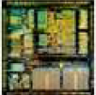
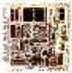

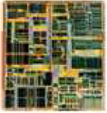

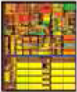
Design Automation is Driving Chip Evolution
1982 – Intel 80286
134K transistors
12MHz; 68.7 mm²
1985 – Intel 80386
275K transistors
33MHz; 104 mm²
1989 – Intel 80486
1.2M transistors
50MHz; 163 mm²
1993 – Intel Pentium
3.1M transistors
66MHz; 264 mm²
1997 – Intel Pentium II
7.5M transistors
300MHz; 209 mm²
1999 – Intel Pentium III
28M transistors
733MHz; 140 mm²
2000 – Intel Pentium4
42M transistors
1.5MHz; 224 mm²
Notes:
Why is this important? because the design automation or software method is driving the chip evolution. This slides show the evolution of Intel CPU, and you can clearly see from time to time, chips are becoming more and more complex. And the layout of the chip is becoming more and more regular. because we are designing chips using algorithms and software, and we must come up with a systematic way to design each component.
This is very different from the early day design of the chip and that is like manually designed so you can see the intel chip here in 1982 literally has no structure.

Slide 4
Advanced Applied Programming for Computer Design Problems
More information can be found in lecture 1
Notes:
This is a very practical course. It is not a theory, it has a lot to do with software engineering. A formal name of this course will be "applied programming for computer design problems." You can find more information in the previous lecture.

Slide 5
Some Questions about the Course
How can I find more materials about C++ learning?
Cpp-now: https://www.youtube.com/user/BoostCon
Cpp-conf: https://www.youtube.com/user/CppCon
Cpp-reference: https://en.cppreference.com/w/
How to know my code is good?
Ask experienced coder to read your code
Dive into the assembly: https://godbolt.org/
What hardware knowledge do I need?
How does this course help me find a job in AI?
Notes:
Some questions I collected from the emails and office hour.
Q1: ... Of course, the best learning is to do it by hand. Computer science is kind of not really a science but a practical discipline, right? You can learn a lot of these new C++ features, trends, and ideas in Cpp-now and Cpp-conf which are two youtube channels that have a lot of video presented by the professionals in the field. For API reference, please refer to the link cpp-reference, and that is the official website for C++. That is the best reference website I have ever seen.
Q2: ...
Q3: ... Not really. But we will learn how to write good code that makes sense to hardware. Because eventually everything happens on hardware, right? We definitely need to know some hardware architecture in order to deliver the best performance.
Q4: ...

Slide 6
Reflect on Big Mod Problem
Compute a^{b} mod c (b is as large as 2147483647)
Naïve method
for(i=1, j=1; i<=b; i++)
j = (j*a)%c;
printf("%d\n", j);
2¹⁶ = 2*2*2*2*2*2*…*2 total 15 calculation
Can we do better?
2¹⁶ = ( 2⁸ )² total 1 calculation
2⁸ = ( 2⁴ )² total 1 calculation
2⁴ = ( 2² )² total 1 calculation
2² = ( 2¹ )² total 1 calculation
2¹ = ( 2⁰ ) total 1 calculation
Notes:
Let's reflect on the big mod problem we discussed last time. The big mod problem is, given three integers a b c, possibly very very large, compute this: a to the b modulo c. That means, you multiply a by b times, and you divide the result by c, and return the remainder as the solution. (repeat)
The straightforward method is to write a loop of b iterations where in each iteration you keep multiplying the result by a and divide that by c. The reason we can do this is the linearity of modulo operation. The result of a to the b modulo c is equal to b multiplications of a modulo c. Then we can write down this very simple loop based algorithm, and the number of iterations you need is essentially the b.
We also talked about a better solution using divide and conquer. We can break down the computation by dividing b by 2. If b is an even number, the result is simply the multiplication of each half. For example, 2 to the 16 is the square of 2 to the 8. By doing this, we only need to compute half value and save a lot from duplicate computations.

Slide 7
Refined Solution
#include <iostream>
using namespace std;
#define SQUARE(x) (x*x)
int bigmod(int a, int b, int c)
{
if(b==0) return 1;
else if(b%2==0)
return SQUARE(bigmod(a,b/2,c)%c)%c;
else return ((a%c)*bigmod(a,b-1,c))%c;
}
int main()
{
int a,b,c;
while(std::cin >> a >> b >> c) std::cout<<bigmod(a,b,c)<<endl;
return 0;
}
DO NOT globalize the namespace!!!
Notes:
This is the refined solution that used this idea of divide and conquer. We wrote this program in a recursive manner.
One thing I woulde like to point out if, when you are writing c++ programs, do not say "using namespace std" because this is going to globalize the namespace. Namespace is a way to avoid name conflicts between different libraries. For example, your library ...
How do we avoid this problem? That's the use of namespace, you define every single function in your library under a namespace, and I definie every single function in my library under a namespace. Of course, your namespace should have a different name from my namespace. When you want ot use a particular function or object, you explicitly specify the namespace. This hierarchy can avoid conflicts in naming variables or functions.

Slide 8
In fact, there is a name for the refined method:
Divide and Conquer algorithm
(used to solve >50% computer design problems, including Google’s distributed system solutions, e.g., MapReduce)
Notes:
...
This is really important. Everything marked in red has very high chance to show up in the exam.

Slide 9
An Iterative Version
All recursive problems can be rewritten iteratively
int64_t bigmod(int64_t a, int64_t b, int64_t c) {
int64_t result = 1;
while(b > 0) {
if(b & 1) {
result = (result * a) % c;
}
b = b >> 1;
a = a*a%c;
}
return result;
}
See: https://godbolt.org/z/RVxZRN

Slide 10
Get a Sense of Runtime Performance
Time complexity analysis
Runtime plays the most important role in performance
In algorithm theory, we use big O worst case analysis
Upper bound of the runtime with respect to input size N
In this course, we will use TW’s empirical analysis as with modern computer architectures
Notes:
Everything we want to pursue here is performance. And the most important performance people care a lot is the runtime performance. the execution time of your program and algorithms. The elapsed time after I hit the button until I see the result.
To understand the runtime performance, you need to know how to analyze the time complexity of your algorithm, or the efficiency of your algorithm. In algorithm theory, we typically use big O worst case analysis. Mathematically, It is the "closest upper bound" of the runtime with respect to the input size N. For example, if your algorithm simply takes a linear scan over all input data, we say the complexity is O(N). of course you can also say it as O(N^2) but we care the "minimum upper bound", the "closest upper bound" to cover the complexity of your algorithm.
But, this seems mythical. It doesn't acutally give us the runtime value of an algorithm even though it might be just an approximation. So in this course, we will use "..."

Slide 11
Empirical Analysis
Technical Analysis(Input Data Size = N)
O(N)
for(int i=1; i<=N; i++) some_constant_work();
O(N²)
for(int i=1; i<=N; i++)
for(int j=1; j<=N; j++)
some_constant_time_work();
O(N³), O(N⁴)…
On modern computers, input Data Size = N
O(N) = 1000000 ~ 8000000 equals to Run Time < 1s
Generally true on modern PCs
Notes:
The empirical analysis has two parts: first you need to know the big O complexity of your algorithm with respect to an input size N.
...
With N in 1 millions to 8 millions, that gives u about 1 second running on a modern PC, modern computer architectures. Because the clock is not going to run faster forever, the power disaption problem limits the clock speed. And that is why this type of value makes sense in modern computers.

Slide 12
Empirical Analysis Examples
A Problem with N = 1000, Time Limit = 1s
Could a O(N) algorithm pass the time limit constraint?
What about the O(NlogN)?
What about the O(N²) ?
What about the O(N² logN) ?
What about the O(1) time ?
A Problem with N = 1000000, Time Limit = 1s
Could a O(N) algorithm pass the time limit constraint?
What about the O(logN) ?
What about the O(logN logN) ?
What about the O(N²) ?
Notes:
Now let's look at some examples of this empirical analysis. This is also the second question you need to finish in today's question.
Let's use log to the base 10 (it doesn't matter mathematically since we only care about the upper bound)

Slide 13
What about Space Complexity?
Same as the empirical runtime analysis
However, it depends on your RAM size
Stack vs Heap
Notes:
What about space complexity?
But I would like to spend a bit of time talking about the memory hierarchy when you are running a program. Typically, there are two types of memory you will use, Stack and Heap. When you launch a program, the OS will preallocate a fixed amount of memory space for your program. That will used by for example, local variable, global variable, and other data that can be decided "statically". Roughly speaking, static data means those declared at programming time. (explore ... )
The problem of the stack is the size is fixed. So you cannot create a very large array in a local function and that will give you stack overflow. This gives rise to another memory type called heap. Heap is the memory block which is normally much larger than stack. It is created at runtime using the function call "malloc". This is the size we normally measure in space complexity.

Slide 14
Before we talk about D&C …
Recursive program is the backbone of D&C
Fibonacci number
Notes:
Before we talk about divide and conquer, we have to dive into recursive programs a bit more. Recursive program is the backbone of Divide and Conquer. It is also a natural way to express a problem with recursive formula. One of the most famous example is the fibonacci number, each number is the sum of the previous two numbers.

Slide 15
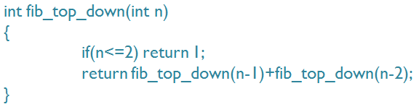
A Simple Recursive Solution
What is the problem?
Notes:
So, it can be written nicely with recursion. A function fib_top_down with an input argument, n, if n is less or equal to two, return 1, or return recursively the sum of the two previous fibonacci number values.
What is the problem of this code?

Slide 16
Duplicate Computations …
Fib(5)
Fib(4)
Fib(3)
Fib(3)
Fib(2)
Fib(2)
Fib(1)
Fib(2)
Fib(1)
Fib(1)
Fib(0)
Fib(1)
Fib(0)
Fib(1)
Fib(0)
What is the big-O complexity?
Notes:
Now let's take a look at how this algorithm work

Slide 17
Tabular Method
Problems
Duplicate calculation
F(30) will blow up the runtime
Solve by table Weapon
Four Steps
(1) Basic and Valid Condition
(2) Is Found Condition
(3) Recursive Part
(4) Return Value Part
bool isfind[MAXN]; //all initialized to be false
int fib[MAXN]; //all initialized to be zero
int tabular(int n)
{
if(n<=2) return 1;
if(isfind[n]) return fib[n];
fib[n] = tabular(n-1) + tabular(n-2);
isfind[n] = true;
return fib[n];
}
Notes:
There is a very common approach to avoid this problem of duplication calculation, the tabular method. The idea of tabular method is to record the solution when you find it such that next time you want to query the same value, I can simply return the solution from the table.
The tabular method has four steps, and this is the golden formula from my 10 year experience in software engineering. (explain...)
Using the same fibonacci example, we have the following

Slide 18
The Hanoi Problem
Given three sticks, what’s the number of steps required to move the tower of n blocks from the first stick to the last stick. You cannot put a large block on the small block
Notes:
Another famous example of recursion is the hanoi problem.

Slide 19
Example of Two Blocks
Example with a 2-block tower.

Slide 20
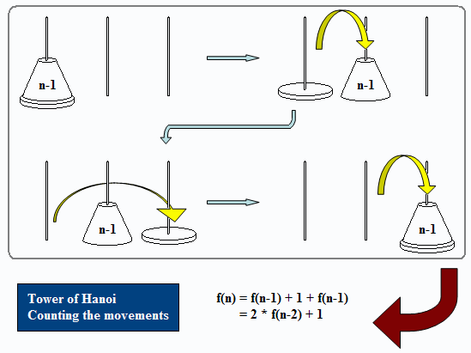
Recursion Formula
Notes:
If you follow this step, the recursion formula is like this: f(n) which is the number of movements to move N blocks from one stick to another. This is equal to moving the top n-1 blocks from the first stick to one stick first, then move bottom most block that is the largest block to the last stick, and then move the n-1 blocks on top of the largest block.
So fn equals f(n-1) + 1 + f(n-1)
This is one question you will need to finish in today's class.

Slide 21
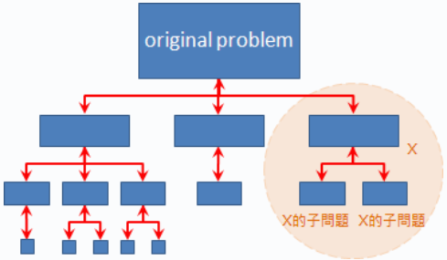
Divide and Conquer
Divide & Conquer
Divide: Divide the original problem into smaller subproblems
Recurse: Solve each small subproblem recursively
Conquer: Combine these subproblems all the way to the top
Illustration
subproblems
Notes:
Now we understand what recursion works, it's time to dive into divide and conquer. A normal divide and conquer algorithm has three steps: divide, recurse, and conquer.
Divide ...
Recurse: ...
Conquer:
In terms of figure, it looks like this. (explain)

Slide 22
Time Complexity of Divide and Conquer
Time Complexity Analysis of D&C
Usually Nlog(N) time
k: the divided size
s: split
m: merge
Notes:
This is the formal formula of divide and conquer algorithms. We are not going to dig this out but will learn the complexity of a divide and conquer algorithm from examples. Usually the complexity is N log N.

Slide 23
Visualization of Divide and Conquer
Divide
If small
else
Solve Directly

Slide 24
Visualization of Divide and Conquer
Recursive

Slide 25
Visualization of Divide and Conquer
Solve and Conquer

Slide 26
Divide and Conquer is Heavily used in CAD
Modern circuits sizes are too large to handle in flat
2000 – Intel Pentium4
42M transistors
1.5MHz; 224 mm²
Directly solving the original problem takes forever to finish …
Notes:
Like I said, Divide and Conquer is heavily used in CAD. Modern circuit sizes are just too large to handle in flat. If you do this, it means billions of transistors at one time. You have no hope to finish it in a reaonsable amount of time. To give you a sense on the size, when I was working in IBM ....( explore )

Slide 27
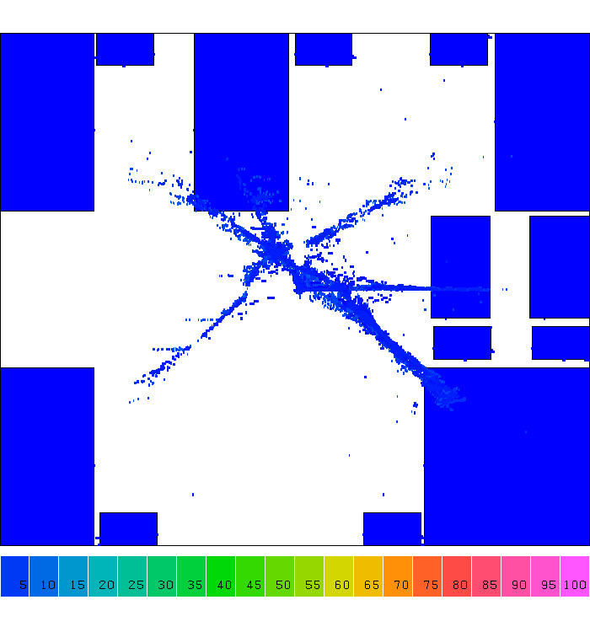
Example: Placement
Notes:
Let's take a look at one step of computer design, placement. A placement is a step that tries to find the location of each gate, you know Or gate, NAND gate, NOT gate, and other gates, in a chip area. And we have billions of gate to place in a finger size chip.
Computer design tools don't do this. They do this in divide and conquer. (explain)

Slide 28
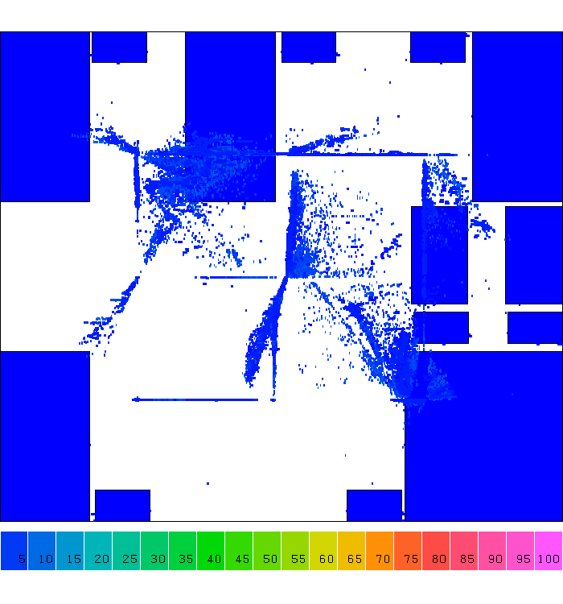
Example: Placement

Slide 29
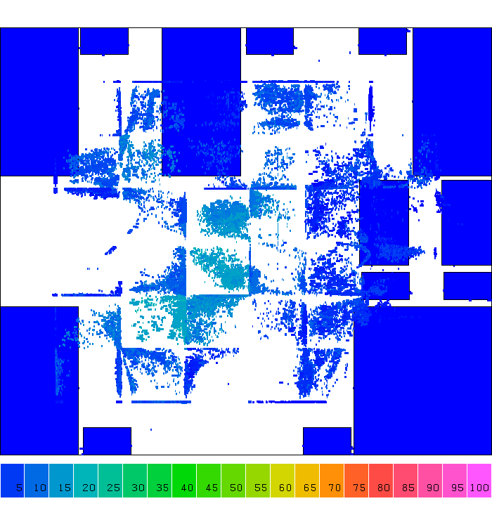
Example: Placement

Slide 30
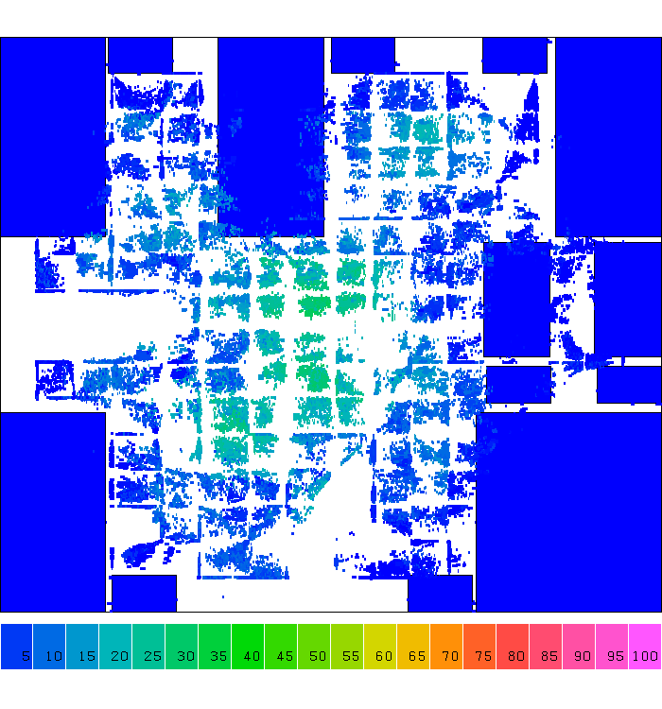
Example: Placement

Slide 31
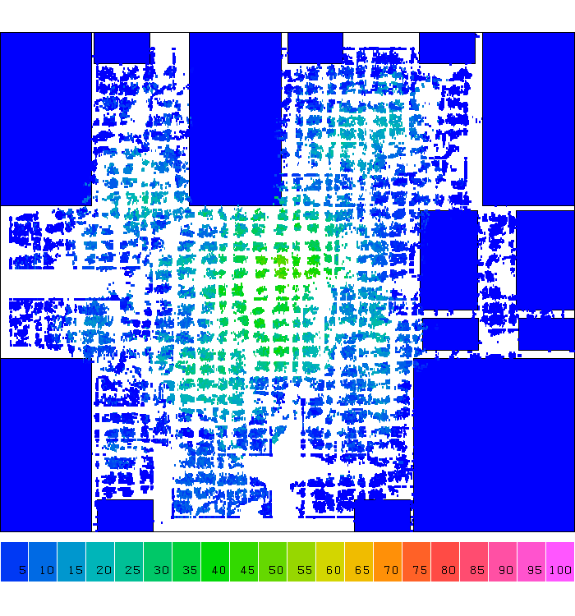
Example: Placement

Slide 32
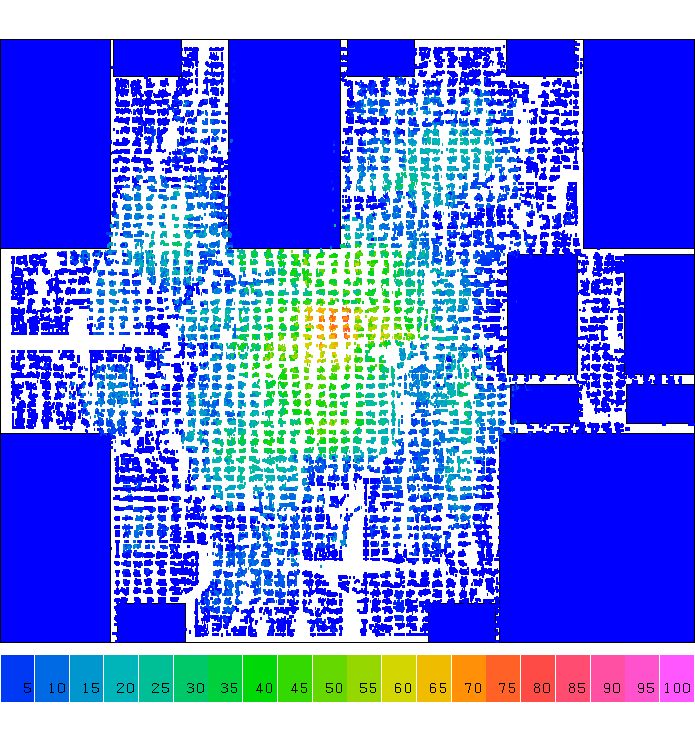
Example: Placement

Slide 33
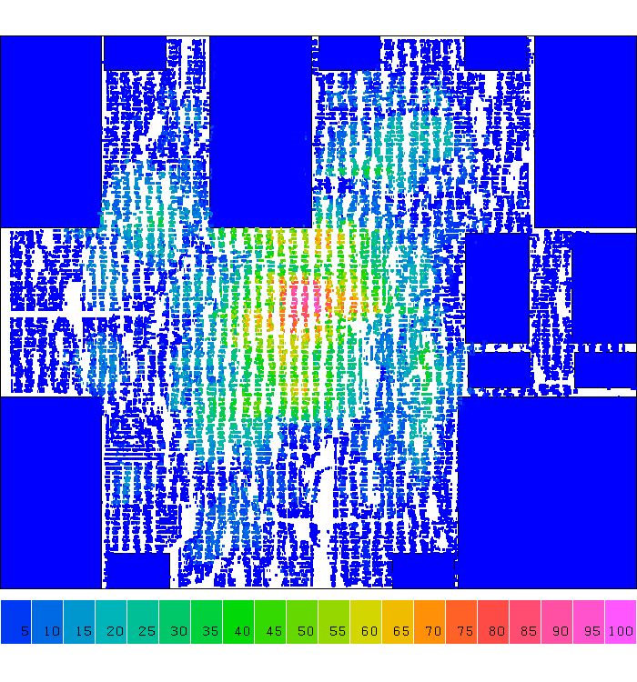
Example: Placement

Slide 34
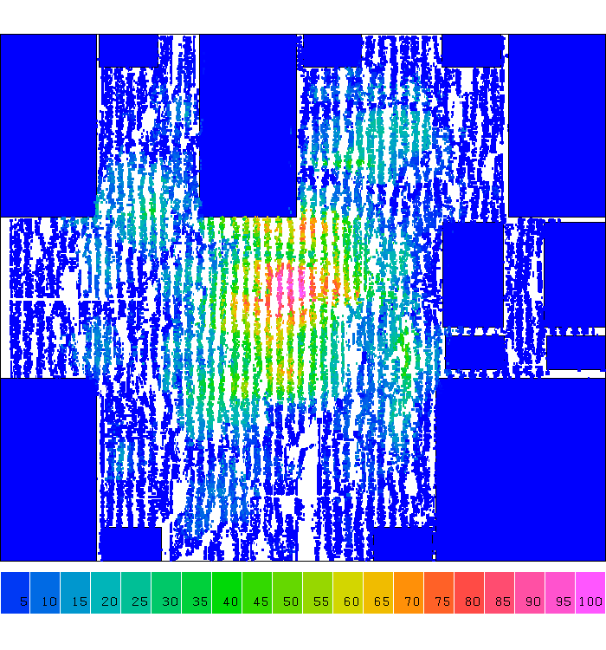
Example: Placement
Notes:
So, from iteration to iteration you can clearly see cells are placed very regularly, right, Cells are spreading along the 2D grid partition. We partition the large chip care into smaller grids and place cells in those small grids. Solving the smaller grid problem is definitely more efficiently than directly handling the original problem.

Slide 35
Example: Find the Maximum Value
Divide
29
14
15
01
06
10
32
12
29
14
15
01
06
10
32
12
29
14
15
01
06
10
32
12
Notes:
Now let's take a look at a simpler example, finding the maximum value in a linear sequence of numbers. For example, in this sequence I have 29, 14, ... (explain) and the maximum value I need to return is 1 and that is the forth element from the beginning.
First step, divide, the convention is to divide the problem by 2, breaking the sequence into tow equal size halfs.
...

Slide 36
Example: Find the Maximum Value
Conquer
32
29
32
29
15
10
32
29
14
15
01
06
10
32
12
Notes:
A partition with two elements seems pretty reasonable to solve. I can simply compare these two numbers and return the maximum, right.
So I will compare 29 with 14 and return 29 as the maximum from my partition. I am returning 29 to the previous recursion. At the same time, on the right hand side, I am comparing 15 with 01, and apparently 1 is smaller than 15 so I return 15 to the previous recursion.
Same for the other two blocks ...
Now I have the maximum from each partition, the conquer part is to find the maximum value from the returned values of partitions. So, here I will compare 29 with 15 ...
You may ask, can't I just do a linear scan over the sequence and I will find the maximum number? What is the advantage of doing this in divide and conquer kinda more complex?

Slide 37
Example: Find the 2D Maximal Points
A point A (x1, y1) dominates B (x2, y2) iff x1 > x2 and y1 > y2.
Y
A
A dominates B
B
X
Notes:
The next very famous example I am going to talk about is the 2D maximal point finding problem. This is not just useful in many practical applications, but also a frequently asked question during the software job coding interview.
A point A ...
In this example, we can clearly see A dominates B because ...
So the goal is, given a set of points in a 2D plane, find all the maximal points. Any question about the problem statement? (repeat)

Slide 38
Example: Find the 2D Maximal Points
Brute-force method
Write a two-level for-loop to compare all pair of points
Compare all pairs of points Time Complexity：O(n²)
Y
X
Notes:
You might immediately come up with a very simple solution, a brute force method. You write a two-level for-loop to enumerate all pairs of points and check whether one dominates another. If one point is dominated by another, we can kick it out. In this example, we have totally 5 points, this one this one htis one ... Because you can't find other points that dominate these 5 points.
This simple brute-force method of comparing all pairs of points has a time complexity O(N square) because each iteration is upper bounded by N which is the number of points, and you have a nested for loop of two which gives you N square complexity.
Again, the question is, can we do better?

Slide 39
Find 2D Maximal Points using Divide and Conquer
Input: A set S of n planar points (sorted along x).
Output: The maximal points of S.
Step 1: If S contains only one point, return it as the maxima. Otherwise, find a line L perpendicular to the X-axis which separates S into S_{L} and S_{R}, with equal sizes.
Step 2: Recursively find the maximal points of S_{L} and S_{R} .
Step 3: Find the largest y-value in S_{R}, denoted as y_{R}. Discard each of the maximal points in S_{L} if its y-value is less than y_{R}.

Slide 40
Algorithm Illustration
Step 1
If only one point
else
Y
Y
L
S_{L}
S_{R}
maxima
X
X

Slide 41
Algorithm Illustration
Step 2
Y
L
L
S_{L}
S_{R}
X

Slide 42
Algorithm Illustration
Step 3
Y
L
S_{L}
S_{R}
X
Notes:
Now the interesting point is the conquer part. You need to combine the maximal points returned from two partitions Sl and Sr into a correct maximal point set. The point returned from SL is the maximal point in that subproblem and the point returned from SR is the maximal point in that subproblem. We cannot simply combine them because the maximal points from SL might be dominated by the points from SR. We have to rule out thses points.
For example, these are the three points returned from SL and these are the three points returned from SR. And this point is apparently not the one I want, because it is dominated by this point at SR. Question: how can we do this efficiently?

Slide 43
Summary
Divide and Conquer is a recursive algorithm
Three essential steps:
Divide: If the input size is too large to deal with in a straightforward manner, divide the data into two or more disjoint subsets.
Recurse: Use divide and conquer to solve the subproblems associated with the sub datasets.
Conquer: Take the solutions from the subproblems and “merge” them to a solution from the division point.

Slide 44
Note
To compile a “test.cpp” program to a binary “test”
g++ test.cpp -O2 -o test
To feed a program with a test file from the standard output:
./simple < test.txt
To measure the runtime of the above program:
time –p ./simple < test.txt

